Slide 1
Assisted Reproductive Technology
What’s not to love?
Donna J. Harrison M.D.
Men’s Conference

Slide 2
Disclosures
I currently serve on the Board of Directors for the National Embryo Donation Center (NEDC)
I served on the CTCR committee on IVF and Embryo Adoption.

Slide 3

“Therefor a man shall leave his father and mother and shall cleave unto his wife, and they shall be one flesh.” Gen2:24 KJV
“Echad” Hebrew “unified oneness”.

Slide 4
And He answered and said to them, “Have you not read that He who ^{[a]}made them at the beginning ‘made them male and female,’ ⁵ and said, ‘For this reason a man shall leave his father and mother and be joined to his wife, and the two shall become one flesh’? ⁶ So then, they are no longer two but one flesh. Therefore what God has joined together, let not man separate.” Matt 19: 4-6 NKJV

Slide 5
One flesh manifested by:
One in marital embrace.
One in the human being in the womb.
One in fetal cells in maternal bloodstream.
One in engrafting of fetal cells in brain of mother.

Slide 6
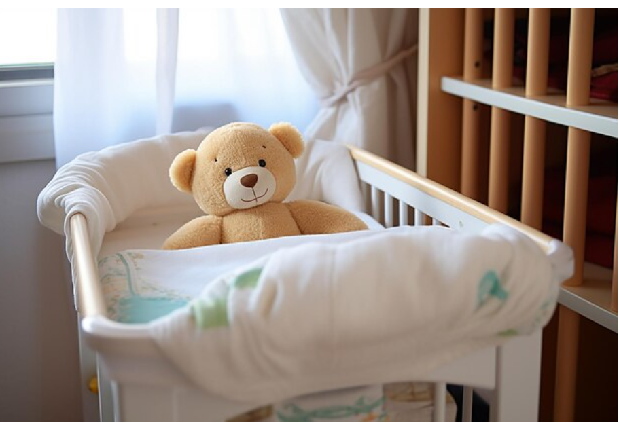
For sale.
Baby shoes.
Never used.

Slide 7
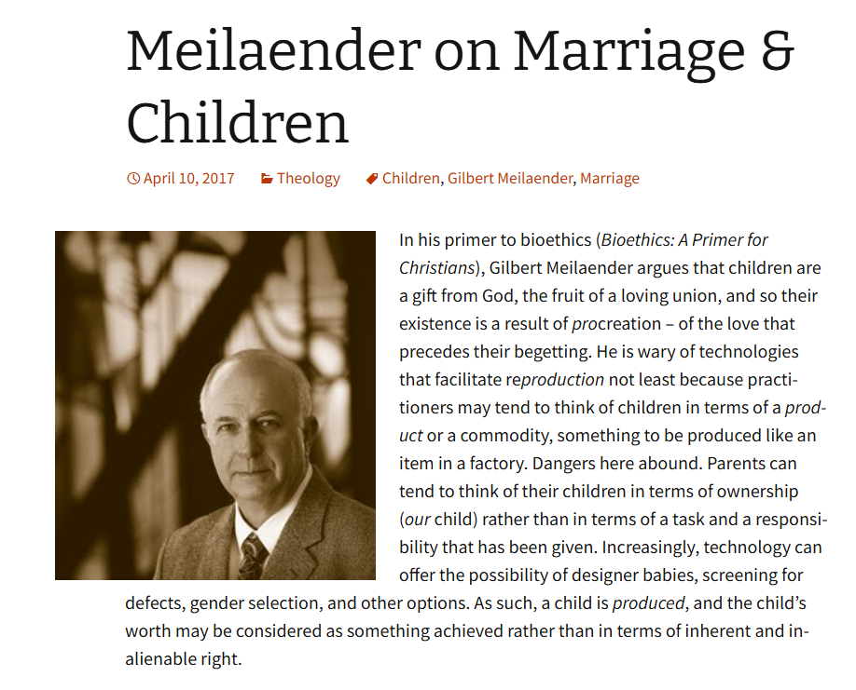
Is conceiving a child a right or a gift?
https://ctsfw.net/media/pdfs/MeilaenderTheChildAsAGiftOfGod.pdf
https://theologyandchurch.com/2017/04/10/meilaender-on-marriage-children/

Slide 8
A Child as a Gift in the Context of Marital Union
A Child as a Reproductive Project
Restorative Reproductive Medicine/ Natural Procreative Technology “Napro”
Assisted Reproductive Technology / In Vitro Fertilization “IVF”

Slide 9
IN RRM / NAPRO
IN ART/IVF
One egg
Natural sorting of sperm
Tubal transport “rolling”
God decides who lives
Natural preparation of womb for implantation
Context of “gift”
10-30 eggs
Selection of sperm based on visual motility by doctor
Culture in petri dish
Dr. decides which embryo’s live
Forced timing in artificially prepared womb
Context of “manufacture”

Slide 10
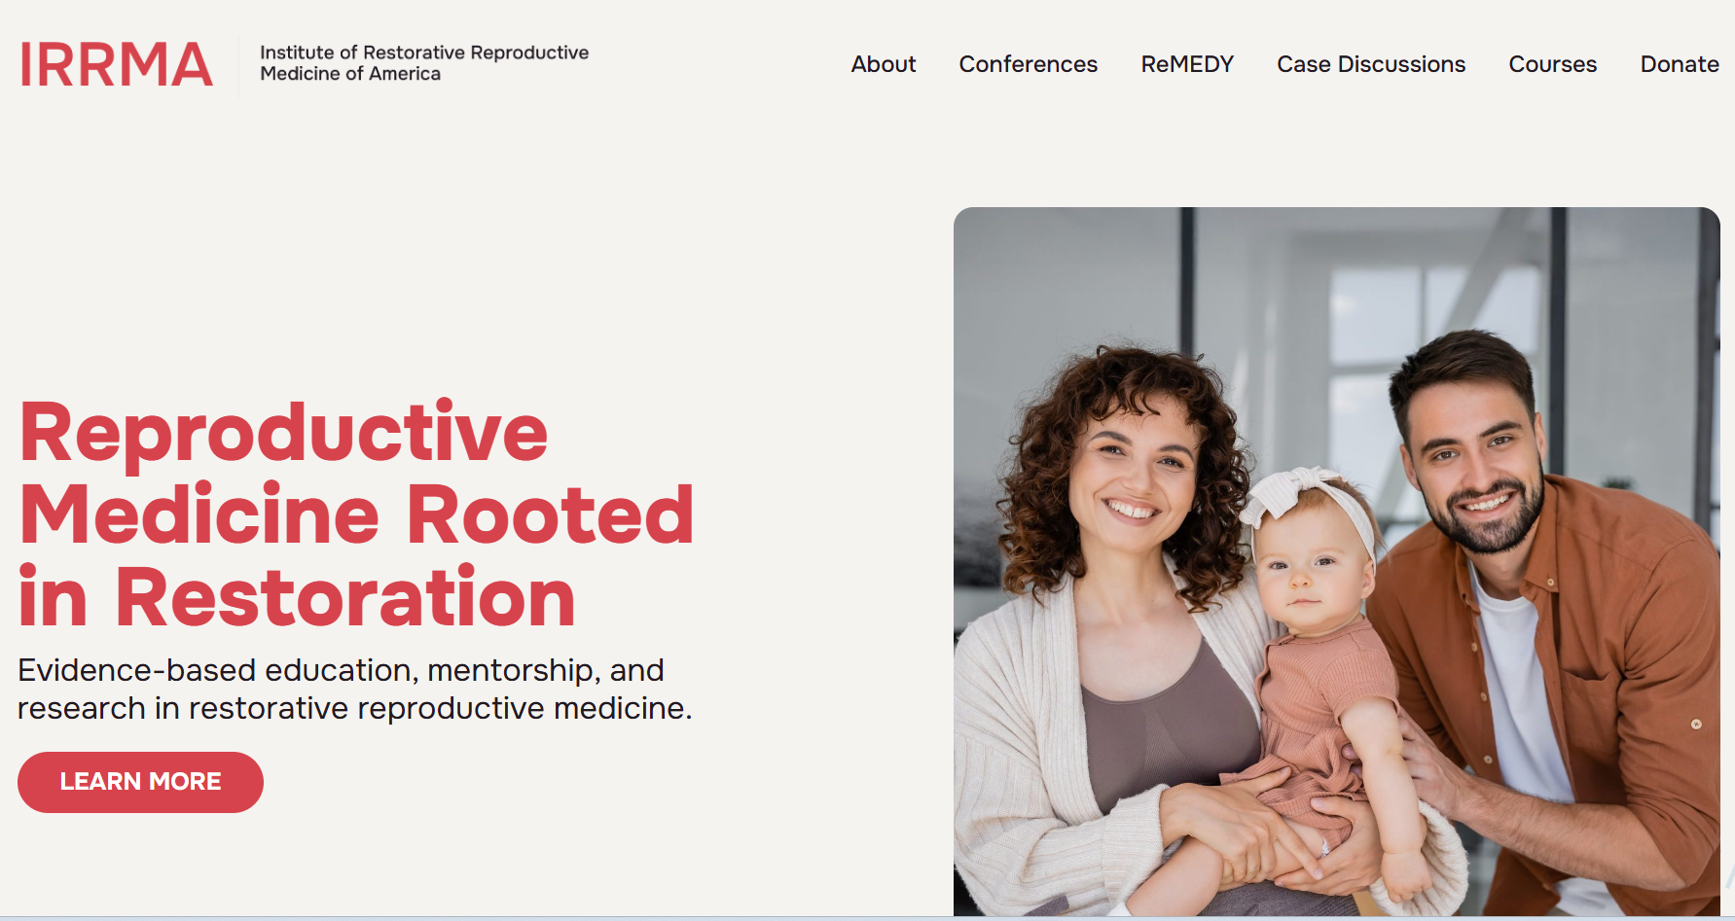

Slide 11
The Restorative Reproductive Medicine (NaProTECHNOLOGY)
Looks for and treats the underlying causes of the reproductive abnormality.
Assists the couple in achieving pregnancy while maintaining the natural acts of procreation.
If the treatment is unsuccessful, further research into the unknown causes is undertaken.
If medically unsuccessful, the program will assist with successful family building by being supportive of adoption.

Slide 12
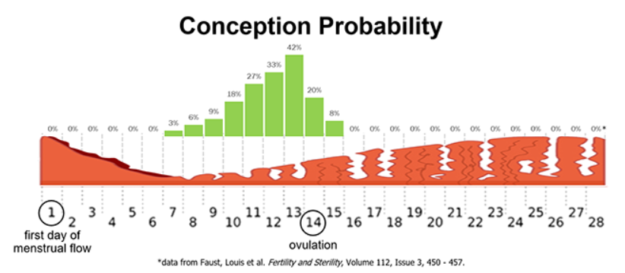

Slide 13
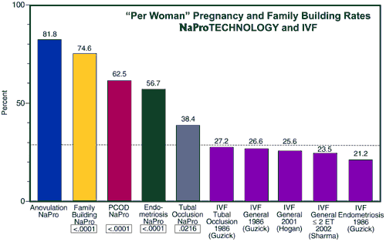

Slide 14
A Child as a Gift in the Context of Marital Union
A Child as a Reproductive Product
Restorative Reproductive Medicine/ Natural Procreative Technology “Napro”
Assisted Reproductive Technology / In Vitro Fertilization “IVF”

Slide 15
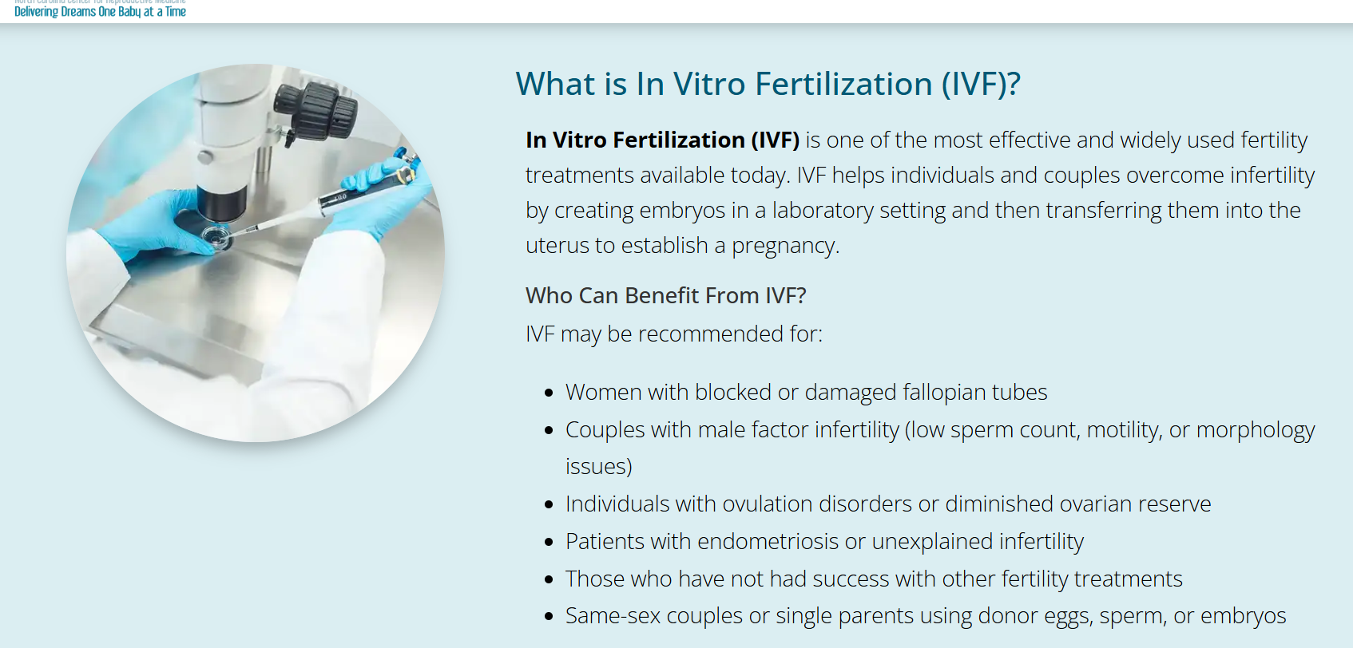

Slide 16




Slide 17
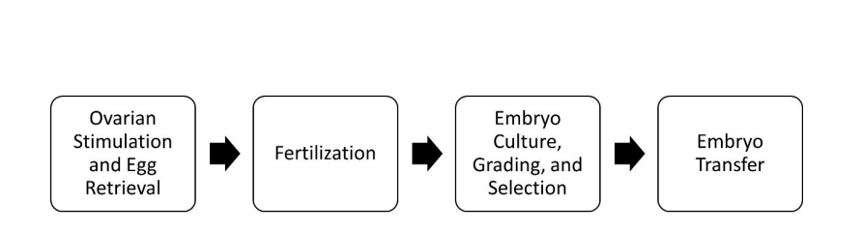
Assisted Reproductive Technology / IVF

Slide 18
Assisted Reproductive Technology / IVF

Slide 19

Ovarian Stimulation and Egg Retrieval
Normally one egg is produced each month in a woman’s body.
In order to get lots of eggs, the ovary has to be stimulated with hormones to cause the ovary to “super-ovulate”. This can lead to OHSS

Slide 20
Ovarian Stimulation and Egg Retrieval
Ovarian Hyperstimulation: (1 out of 3 women )
Mild to moderate abdominal pain
Bloating , Nausea, Vomiting, Diarrhea
Tenderness in the area of your ovaries
Some women who use injectable fertility drugs get a mild form of OHSS, which goes away after about a week. If pregnancy occurs, however, symptoms of OHSS may worsen and last several days to weeks.
https://www.asrm.org/FACTSHEET_Ovarian_Hyperstimulation_Syndrome/

Slide 21
Ovarian Stimulation and Egg Retrieval
Severe Ovarian Hyperstimulation: 1-2% of women
Fluid collection in the abdomen and sometimes the chest
Electrolyte disturbances (sodium, potassium, others)
Blood clots in large vessels, usually in the legs
Kidney failure
Twisting of an ovary, or Rupture of a cyst in an ovary, which can lead to serious internal hemorrhage requiring surgery and removal of the ovaries.
Breathing problems requiring intubation and ventilator support
Death of the fetus.
Rarely, mother dies.

Slide 22
Ovarian Stimulation and Egg Retrieval
OHSS (Ovarian Hyperstimulation )
Complicated deliveries
Ovarian cancer (some types) from the hormones used to stimulate the ovaries
Increased risk of breast cancer? From estrogen surge secondary to superovulation

Slide 23
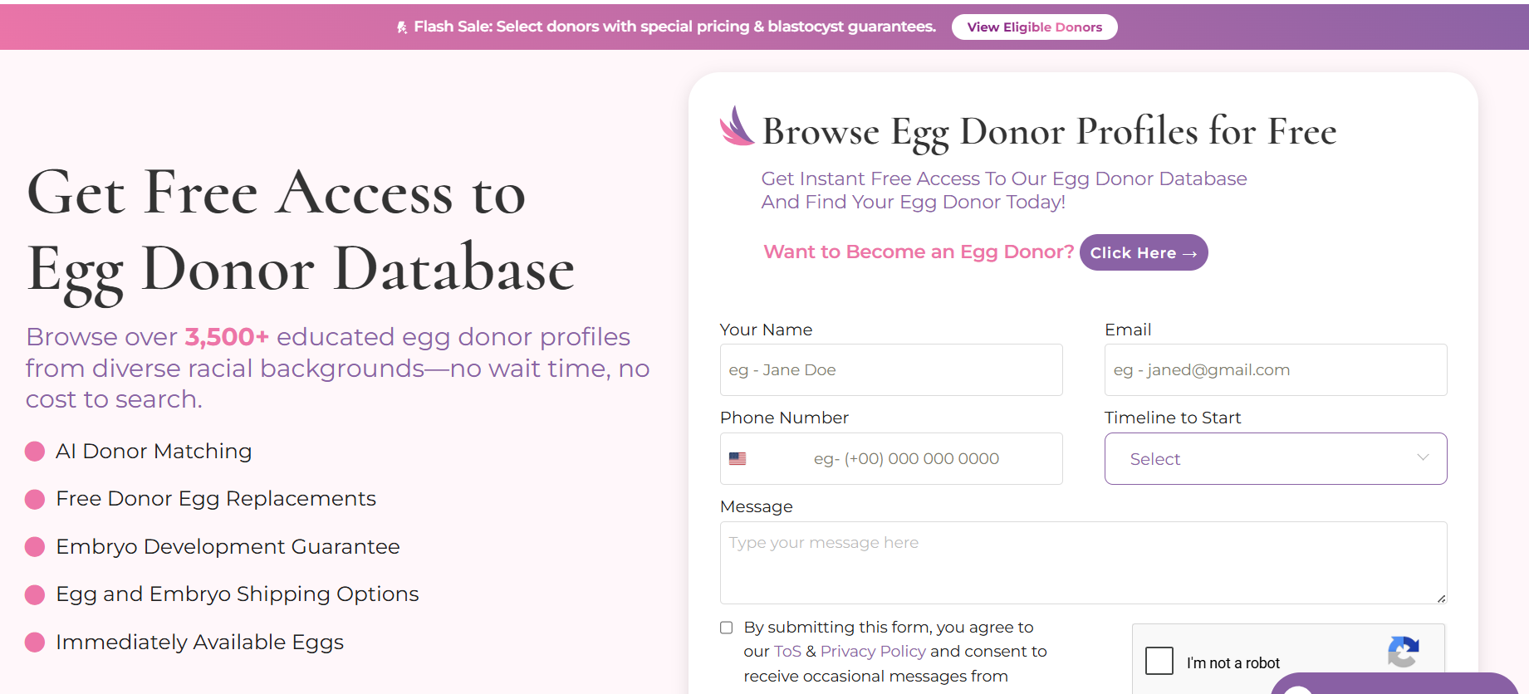

Slide 24
Eggsploitation
https://www.youtube.com/watch?v=GOzw2hmMHXg

Slide 25
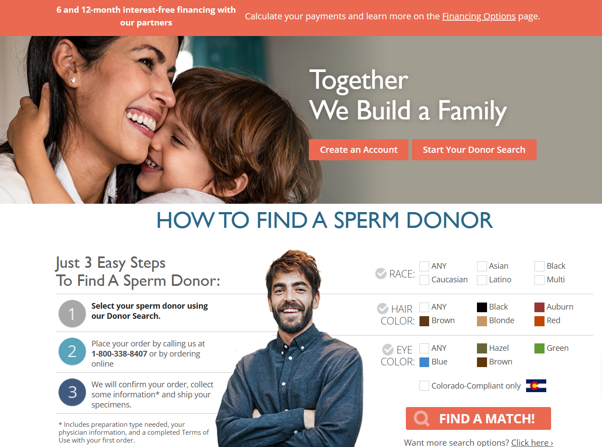

Slide 26
Assisted Reproductive Technology / IVF

Slide 27
http://www.today.com/video/moment-of-conception-egg-fertilized-live-on-tv-49756739602
2:04-3:30

Slide 28
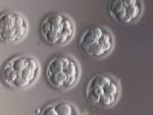
Embryo Culture Grading and Selection
In the Nat’l Geographic Video- 23 embryos were created.
3 were transferred into the mother’s womb.

Slide 29
Assisted Reproductive Technology / IVF

Slide 30
Embryo Culture Grading and Selection
Of embryos transferred, only one out of three will survive to live birth.
How many should be transferred?
Which ones should be transferred?
What do we do with the “leftovers”?

Slide 31
Embryo Culture Grading and Selection
What do we do with the others?
Freeze them to implant later
Freeze them and donate them to someone else
Let them die.
Experiment on them.

Slide 32
Embryo Freezing
“Freezing doesn’t hurt the embryos.”
An embryo is as good as fresh if 100% of cells are alive but this only happens in 3 out of 10 embryos thawed.
4 out of 10 embryos who survive the thaw have >50% but less than 100% of the cells are alive after thawing.
An embryo has “partially survived” if <50% of its cells are alive (1 out of 10 embryos)
An embryo is dead if no cells survive (2 out of 10 embryos),
http://www.givf.com/fertility/embryofreezing.shtml

Slide 33
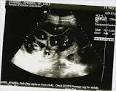
Embryo Culture Grading and Selection
In 2000, more than 2/3 of all IVF procedures involved transfer of three or more embryos. But the complication rate for triplet deliveries is greatly increased for the mother and the triplets…good chance they will be premature and die.

Slide 34
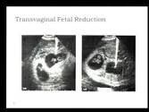
Embryo Culture Grading and Selection
So, we could just let them grow, then kill off one or two in the womb…. “selective embryo reduction”

Slide 35

Embryo Culture Grading and Selection
Making the “best”
Hubris of Eugenics
Prenatal Genetic Diagnosis (PGD)
Expectation of the “perfect” child…with imperfect results
Inherently eugenic

Slide 36
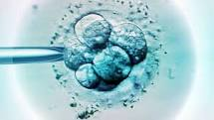
Embryo Culture Grading and Selection
PGD/PGS has been associated with a substantial increased risk of perinatal death compared with standard ICSI (4.6% versus 1.9%; OR 2.56
In Vitro Fertilisation: Perinatal Risks and Early Childhood Outcomes Scientific Impact Paper No. 8 May 2012

Slide 37
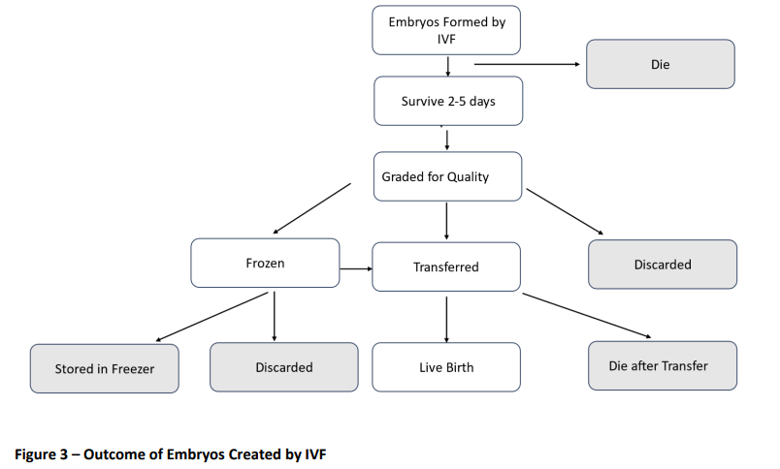

Slide 38
20 year review of IVF in the U.K.
3,546,818 Embryos created
1,388,443 transferred (39% of created)
2,158,375 never transferred
(61% of created)
2071 Donated (Embryo adoption)
(0.05% of embryos created)
(0.1% of embryos transferred)
200,000 births
(5% of created)
(14% of transferred)
http://www.dailymail.co.uk/news/article-2255107/1-7-million-embryos-created-IVF-thrown-away-just-7-cent-lead-pregnancy.html#ixzz3lusZXFjZ

Slide 39
20 year review of IVF in the U.K.
2,158,375 never transferred
(61% of created)
http://www.dailymail.co.uk/news/article-2255107/1-7-million-embryos-created-IVF-thrown-away-just-7-cent-lead-pregnancy.html#ixzz3lusZXFjZ

Slide 40
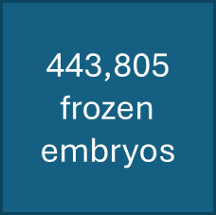


20 year review of IVF in the U.K.
2,158,375 never transferred
(61% of created)
5876 (1.6%) Sent to research labs
http://www.dailymail.co.uk/news/article-2255107/1-7-million-embryos-created-IVF-thrown-away-just-7-cent-lead-pregnancy.html#ixzz3lusZXFjZ

Slide 41
“In the current practice of in vitro fertilization (IVF), some patients may create more embryos (fertilized eggs) than they need…”

Slide 42
“In the current practice of in vitro fertilization (IVF), some patients may create more embryos children (fertilized eggs) than they need…”
“Human children that are discarded every day as medical waste from in vitro fertilization (IVF) clinics could be an important source of stem cells for research,” according to a team of researchers at Children's Hospital Boston.

Slide 43
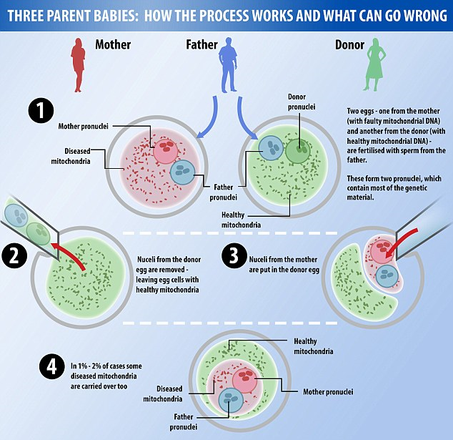
This is an embryo
This is an embryo
This is a different embryo

Slide 44

How did we get into this mess?
Cost of IVF

Slide 45
How did we get into this mess?
Cost of IVF
Fresh Cycle Costs
$20,000-$30,000 for 5 step process for each attempt
Usually only 1 of 3 eggs will fertilize, (average harvest 6 -8eggs)
Usually only 1 of 4 embryos survive after being transferred into a womb,
so average transfer is 3-4 embryos.
If no embryos are frozen, then each attempt requires the full 5 step process .
4 tries x $30,000= $120,000

Slide 46
Live birth rate somewhere around one out of 4 cycles.
(? # to transfer?)
Hyperstimulate to make eggs
Harvest the eggs
Fertilize the eggs
Preimplantation Genetic Diagnosis to find the “Best embryo”
Insert the embryo into the womb
Total avg cost per Fresh cycle =
$20,000-$30,000
Add $3000-$5000 per cycle for meds
FRESH CYCLE
Each crank of this cycle costs $12,000 to $15,000
Only about 1/3 eggs will fertilize.
Add $3000 to $6000

Slide 47
Live birth rate somewhere around one out of 4 cycles.
(? # to transfer?)
Hyperstimulate to make eggs
Harvest the eggs
Thaw the embryos
Preimplantation Genetic Diagnosis to find the “Best embryo”
Insert the embryo into the womb
3 out of 10 embryos will successfully thaw with all cells alive..
Add $3000 to $6000

Slide 48
Live birth rate somewhere around one out of 4 cycles.
(? # to transfer?)
Hyperstimulate to make eggs
Harvest the eggs
Thaw the embryos
Preimplantation Genetic Diagnosis to find the “Best embryo”
Insert the embryo into the womb
Total avg cost per Frozen cycle =
$6,000-$11,000
Each crank of FROZEN CYCLE costs $3,000 to $5000
3 out of 10 embryos will successfully thaw with all cells alive..
Add $3000 to $6000

Slide 49
How did we get into this mess?
Cost of IVF
Fresh/Frozen Cycle Costs
1 fresh ($20,000) + 3 frozen ($11,000 x 3) = $53,000
Vs $120,000 for Fresh x 4
BUT Fresh +Frozen REQUIRES FROZEN EMBRYOS….

Slide 50
Assisted Reproductive Technology / IVF

Slide 51
Embryo Transfer
What womb receives the embryo?
One of the (female)person(s) contracting the IVF project?
The woman whose egg was fertilized? (Either the “mother” or a surrogate)
An entirely new woman contracted as a “gestational carrier”?
Note: Biological bonding begins even before implantation. There is hormonal cross-talk between the embryo in the fallopian tube and the mother before implantation.

Slide 52
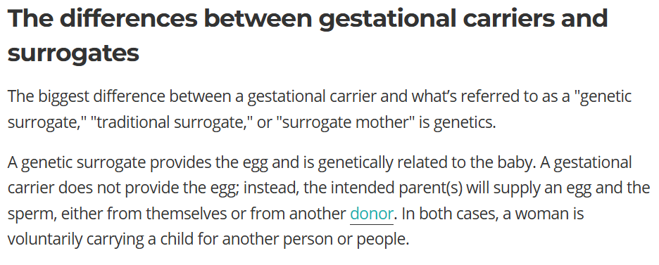
Embryo Transfer

Slide 53
Risks for the IVF Baby
Between 3% and 5% of all infants are diagnosed with a congenital anomaly soon after birth.
IVF is associated with a 30–40% increased risk of major congenital anomalies compared with natural conceptions.
The principal anomalies:
gastrointestinal, cardiovascular and musculoskeletal defects septal heart defects,
cleft lip, oesophageal atresia and anorectal atresia.
Of note, while the relative risk of major congenital anomalies associated with IVF is increased by 30–40%, the absolute risk is nevertheless low since anomalies per se are relatively uncommon.
In Vitro Fertilisation: Perinatal Risks and Early Childhood Outcomes
Scientific Impact Paper No. 8 May 2012

Slide 54
Risks for the IVF Baby
70% increase in the risk of perinatal death for IVF singletons compared with natural conceptions
…women who conceived with IVF had a statistically significant four-fold increased risk of stillbirth compared with fertile women.
In Vitro Fertilisation: Perinatal Risks and Early Childhood Outcomes
Scientific Impact Paper No. 8 May 2012

Slide 55
Serious issues with ART/IVF
Mindset of a child as a “reproductive project” instead of a gift coequal to the parents in human dignity.
Separation of the creation of human beings from God’s context of self-giving love in the marital embrace.
Risks of harm to “egg donor” and to the embryonic human being.
Intrusion into the “one flesh” relationship especially with egg donor, sperm donor, surrogate mothers and gestational carriers.
Intrusion into the “one flesh” relationship even for embryo adoption. This issue does not arise for adoption after birth.

