Slide 1
Men’s Gathering: Beginning of Life Issues
Donna J. Harrison M.D.

Slide 2
5 Questions
What’s in her womb: A blob of tissue or a human being?
Which human beings should we value?
Is abortion healthcare?
If he can walk away, I can walk away?
Who is my neighbor? Pastor Stuckwisch

Slide 3
5 Questions
What’s in her womb: A blob of tissue or a human being?
Which human beings should we value?
Is abortion healthcare?
If he can walk away, I can walk away?
Who is my neighbor? Pastor Stuckwisch

Slide 4
Blob of tissue or Human being?
https://www.youtube.com /@ehdvideos
From the moment of the fusion of sperm and egg membranes.

Slide 5
Blob of tissue or Human being?
“The scientific basis for distinguishing one cell type from another rests on two criteria:
differences in what something is made of (its molecular composition) and
differences in how the cell behaves. ”
“These two criteria are universally agreed upon and employed throughout the scientific enterprise. They are not “religious” beliefs or matters of personal opinion. They are objective, verifiable scientific criteria that determine precisely when a new cell type is formed.”
https://lozierinstitute.org/a-scientific-view-of-when-life-begins

Slide 6
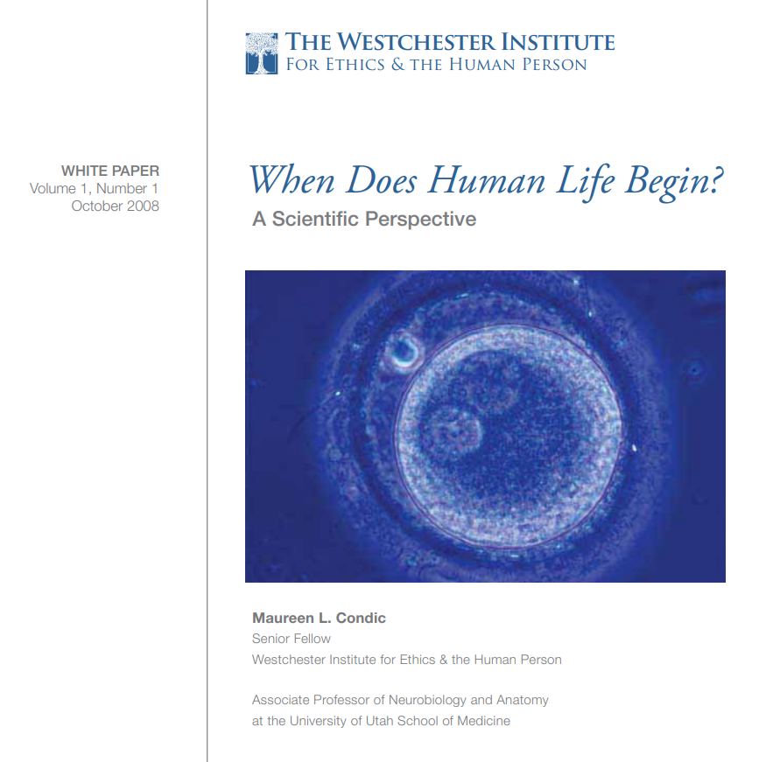
Blob of tissue or Human being?
Composition of a one-celled embryo is different than either sperm or egg
Sperm = 23 paternal chromosomes
Egg = 23 maternal chromosomes
One-celled embryo = 46-47 chromosomes of both paternal and maternal origin
https://www.bdfund.org/wp-content/uploads/2016/05/wi_whitepaper_life_print.pdf

Slide 7
Blob of tissue or Human being?
Behavior of a one-celled embryo is different than either sperm or egg
Sperm = finds an egg
Egg = receives a sperm
One-celled embryo= Directs its own organization into tissues and organs!
https://www.bdfund.org/wp-content/uploads/2016/05/wi_whitepaper_life_print.pdf

Slide 8
Blob of tissue or Human being?
Behavior of a one-celled embryo is different than either sperm or egg
Tissues and organs are “…collections of human cells are alive and carry on the activities of cellular life,
yet fail to exhibit coordinated interactions directed towards any higher level of organization.”
https://www.bdfund.org/wp-content/uploads/2016/05/wi_whitepaper_life_print.pdf

Slide 9
Blob of tissue or Human being?
Behavior of a one-celled embryo is different than either sperm or egg
“Collections of cells do not establish the complex, interrelated cellular structures (tissues, organs, and organ systems) that exist in a whole, living human being.”
https://www.bdfund.org/wp-content/uploads/2016/05/wi_whitepaper_life_print.pdf

Slide 10
Blob of tissue or Human being?
Scientifically, it is clear that a human one-celled embryo is a human organism, a human being
“This conclusion is objective, consistent with the factual evidence, and independent of any specific ethical, moral, political or religious view of human life or of human embryos.”
https://www.bdfund.org/wp-content/uploads/2016/05/wi_whitepaper_life_print.pdf

Slide 11
Blob of tissue or Human being?
“The debate in our society and others is not over when human life begins but is over at what point and for what reasons do we have an obligation to respect and protect that life.
https://www.bdfund.org/wp-content/uploads/2016/05/wi_whitepaper_life_print.pdf

Slide 12
5 Questions
What’s in her womb? A blob of tissue or a human being?
A human being!
Which human beings should we value?
Is abortion healthcare?
If he can walk away, I can walk away?
Who is my neighbor? Pastor Stuckwisch

Slide 13
5 Questions
What’s in her womb? A human being!
Which human beings should we value?
Is abortion healthcare?
If he can walk away, I can walk away?
Who is my neighbor? Pastor Stuckwisch

Slide 14
Which human beings should we value?
We protect
Those we recognize to be like us, human beings, human persons.

Slide 15
Which human beings should we value?
HUMAN BEINGS
HUMAN PERSONS
Entities outside our circle can be treated as property.

Slide 16
Which human beings should we value?
HUMAN BEINGS
HUMAN PERSONS
Slavery
Genocide
Euthanasia
Infanticide
Abortion

Slide 17
Which human beings should we value?
The American Heritage® Medical Dictionary Copyright © 2007, 2004 by Houghton Mifflin Company. Published by Houghton Mifflin Company.
Human Being = n. A human.
Human Person
= the object of legal rights.
There are two kinds of legal person:
1) human beings and
2) artificial persons such as corporations.
Collins Dictionary of Law. (2006). Retrieved June 1 2021 from https://legal-dictionary.thefreedictionary.com/person

Slide 18
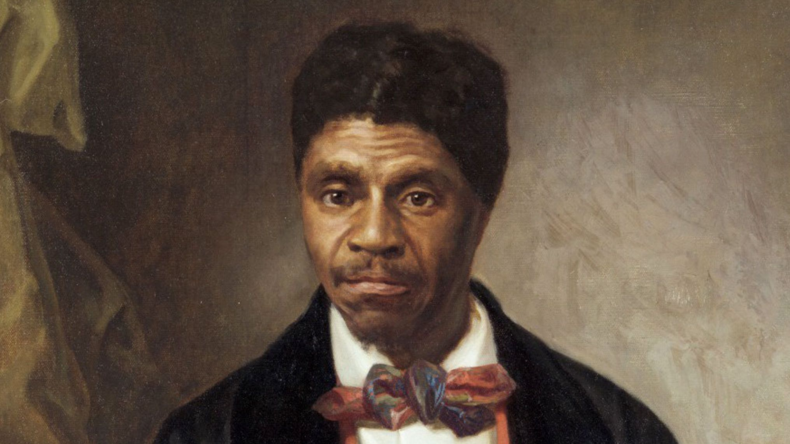
Which human beings should we value?
“The question of whether or not Dred Scott qualified as a "human being" was considered to be a moot one by the Court.
The crucial question was whether or not he qualified as a "person"-- that is, as a full member of American society.”
https://www.jstor.org/stable/pdf/1407800?refreqid=fastly-default%3A0421b6bab1961526dbf02f0760f30a12

Slide 19
Which human beings should we value?
The concept of metaphysical personhood would be to use personhood as a basic category of reality encompassing beings of a certain type: rational, moral agents, using language, etc.
There is no consensus about the exact criteria
“Adult human beings are commonly considered persons, and a very interesting question to ask yourself is that of exactly what it is about us that makes us persons.”
https://medicine.missouri.edu/centers-institutes-labs/health-ethics/faq/personhood

Slide 20
Which human beings should we value?
Criteria for Personhood
Rationality or logical reasoning ability
Consciousness
Self-consciousness (self-awareness)
Use of language
Ability to initiate action
Moral agency and the ability to engage in moral judgments
Intelligence
The concept of metaphysical personhood would be to use personhood as a basic category of reality encompassing beings of a certain type: rational, moral agents, using language, etc.
There is no consensus about the exact criteria
https://medicine.missouri.edu/centers-institutes-labs/health-ethics/faq/personhood

Slide 21
Which human beings should we value?
Criteria for Personhood
Rationality or logical reasoning ability
Consciousness
Self-consciousness (self-awareness)
Use of language
Ability to initiate action
Moral agency and the ability to engage in moral judgments
Intelligence
Does having one or more of these make us a person?
Do we have to have all of them?
Can we have some minimal set?
Does it have to be the same set for all persons?
https://medicine.missouri.edu/centers-institutes-labs/health-ethics/faq/personhood

Slide 22
Which human beings should we value?
S = SIZE
L = LEVEL OF DEVELOPMENT
E = ENVIRONMENT
D = DEPENDANCY
Adapted from Stephen Schwarz The Moral Question of Abortion
https://www.amazon.com/Moral-Question-Abortion-Stephen-Schwarz/dp/0829406239?ref_=ast_author_dp_rw&th=1&psc=1&dib=eyJ2IjoiMSJ9.hpHHaNkG1LkqHdC3rx3YVNFYL4hdW2__00zVEO7g_Z4.YxswUVrUi0qsxK2EtnayjVXxEGV7xRnHMDnBxDwmIFo&dib_tag=AUTHOR

Slide 23

Which human beings should we value?
The human being in the womb is clearly smaller than a born human being.
A four year old is smaller than a fourteen year old.
If we can’t reasonably kill a four year old just because the four year old is smaller than a fourteen year old, then we also cannot reasonably say that we can kill a human being in the womb because he or she is smaller than a born human being
S = SIZE

Slide 24

Which human beings should we value?
S = SIZE
L = LEVEL OF DEVELOPMENT
A human being in the womb is less developed than a born human being.
But, a ten year old is also less developed than a 20 year old.
Since we can’t justify killing ten year old humans simply because they are less developed than 20 year old humans, we also can’t justify killing human beings in the womb because they are less developed than born human beings.

Slide 25

Which human beings should we value?
S = SIZE
L = LEVEL OF DEVELOPMENT
E = ENVIRONMENT
The human being in the womb is in a different environment.
So is an astronaut or a scuba diver.
Since we don’t justify killing scuba divers or astronauts when they are in a different environment, how can we justify killing a human being just because they are a few inches away from being outside the womb?

Slide 26

Which human beings should we value?
S = SIZE.
L = LEVEL OF DEVELOPMENT
E = ENVIRONMENT
D = DEPENDANCY
Humans in the womb are dependent on their mothers.
Newborns, toddlers, preschoolers and early teens are also dependent on their parents, but that does not justify killing them.

Slide 27
5 Questions
What’s in her womb? A human being!
Which human beings should we value? We should value and protect all human beings inside or outside of the womb, from the beginning to the end of their life.
Is abortion healthcare?
If he can walk away, I can walk away?
Who is my neighbor? Pastor Stuckwisch

Slide 28
5 Questions
What’s in her womb? A human being!
Which human beings should we value? We should value and protect all human beings inside or outside of the womb, from the beginning to the end of their life.
Is abortion healthcare?
If he can walk away, I can walk away?
Who is my neighbor? Pastor Stuckwisch

Slide 29
5 Questions
What’s in her womb? A human being!
Which human beings should we value? We should value and protect all human beings inside or outside of the womb, from the beginning to the end of their life.
Is abortion healthcare?
If he can walk away, I can walk away?
Who is my neighbor? Pastor Stuckwisch

Slide 30
Is abortion healthcare?
“Health” What does this mean?
World Health Organization 1948:
Health is a “...[S]tate of complete physical, mental, and social well-being and not merely the absence of disease, or infirmity”

Slide 31
Is abortion healthcare?
“Health” What does this mean?
Sept 21, 2023 Free Medical Dictionary Online:
“…a relative state in which one is able to function well physically, mentally, socially and spiritually in order to express the full range of one’s unique potentialities within the environment in which one is living.”

Slide 32
Is abortion healthcare?
“Health” What does this mean?
Sept 21, 2023 Free Medical Dictionary Online:
“In the words of Rene Dubos, ‘Health is the primarily a measure of each person’s ability to do and become what he wants to become.’ ”

Slide 33
Is abortion healthcare?
“Health” What does this mean?
What happens when what “I want to do and become” (framed as a right to health)
requires someone else to perform an action (duty)
which the person forced to take the action considers to be evil?

Slide 34
Is abortion healthcare?
“Health” What does this mean?
This expansive definition of health is in direct opposition to the Hippocratic Oath, as Hippocratic physicians have vowed to never use intentionally ending a human life as a therapeutic option.
What happens when what “I want to do and become” (framed as a right to health)
requires someone else to perform an action (duty)
which the person forced to take the action considers to be evil?

Slide 35
Is abortion healthcare?
“Health” What does this mean?
Pregnancy is not a disease.
Pregnancy is a normal process of a well-functioning human female body.
Pregnancy is a time when the father, mother and the human being in her womb- her son or daughter, are united in the most profound intimacy in human life.
But that intimacy, and the years of raising a child following birth, requires some degree of self-giving love on the part of the mother and on the part of the father.

Slide 36
Is abortion healthcare?
“Health” What does this mean?
What happens if the father doesn’t want to give that self giving love to the mother for the rest of his and her life?
What if the mother doesn’t want to give that self-giving love to that human being in her womb?
But that intimacy, and the years of raising a child following birth, requires some degree of self-giving love on the part of the mother and on the part of the father.

Slide 37
Is abortion healthcare?
“Health” What does this mean?
What happens if the father doesn’t want to give that self giving love to the mother for the rest of his and her life?
What if the mother doesn’t want to give that self-giving love to that human being in her womb?
This is a real social and spiritual problem.
It is not a medical problem.
Physicians cannot “exercise medical judgment” about social or spiritual problems because physicians are not trained or equipped to address social or spiritual problems.

Slide 38
Is abortion healthcare?
“Health” What does this mean?
What is the social problem that abortion is supposed to solve?
The problem is that there is a living human being in the mother’s womb.
And, someone wants that human being to not survive.

Slide 39
Is abortion healthcare?
“Abortion” What does this mean?
Contrast with “birth”= any separation of the mother and her fetus after 20 weeks gestation (e.g. live birth, stillbirth)
Historically the word “abortion” meant the loss of any pregnancy for any reason prior to 20 weeks gestation.
Thus historically “abortion” included both miscarriages (spontaneous abortions) and induced abortions.

Slide 40
Is abortion healthcare?
“Abortion” What does this mean?
This definition is obviously obsolete and becomes meaningless because “abortions” are now done well after 20 weeks gestation and up until birth.
Historically the word “abortion” meant the loss of any pregnancy for any reason prior to 20 weeks gestation.
Thus historically “abortion” included both miscarriages (spontaneous abortions) and induced abortions.

Slide 41
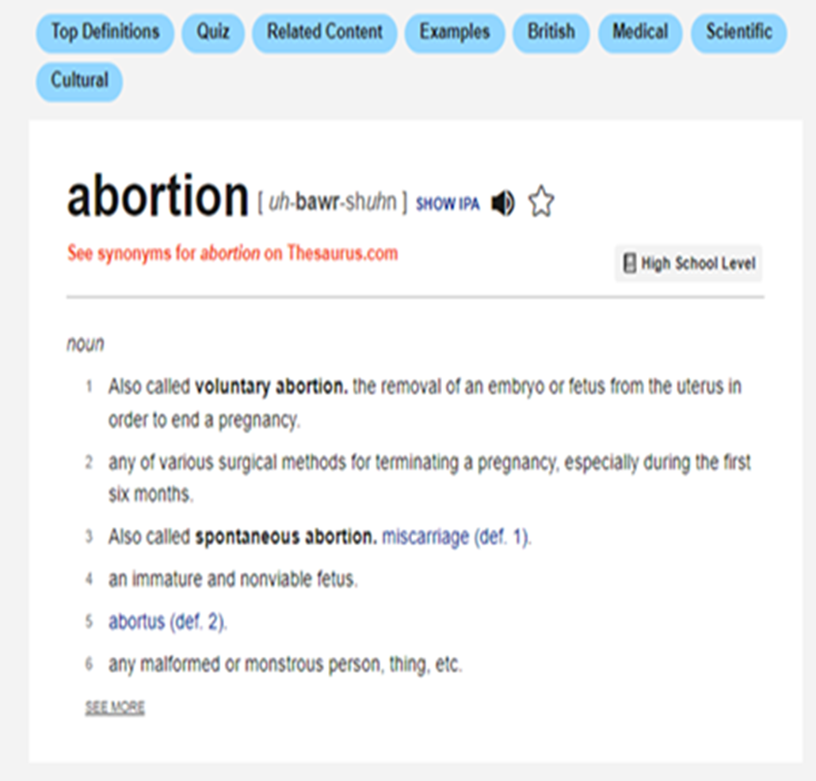
Lay understanding of the term “abortion”
Abortion is the termination of a pregnancy by removal or expulsion of an embryo or fetus.
https://en.wikipedia.org/wiki/Abortion
This definition is clearly absurd because it would include c-sections and vaginal deliveries as abortions

Slide 42
ABORTION
Separation of mother and fetus
“: the termination of a pregnancy after, accompanied by, resulting in, or closely followed by the death of the embryo or fetus:”
http://www.merriam-webster.com/medical/abortion
“Spontaneous”
The separation happens without any human action
“Induced”
The separation happens because of human action
Death of the fetus
To save the life of the mother “Previable Parturition”
At any gestational age
Before 22 weeks gestational age
To produce a dead baby:
"Elective Induced Abortion“

Slide 43
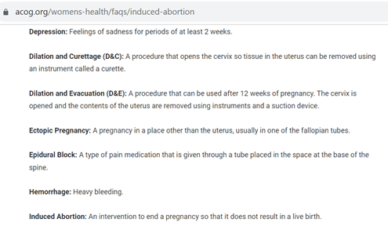
ACOG Concurs….
“Induced Abortion: An intervention to end a pregnancy so that it does not result in a live birth”

Slide 44
ACOG Concurs….
“Induced Abortion: An intervention to end a pregnancy so that it does not result in a live birth”
In plain language: the purpose of an induced abortion is to make sure that the baby does not survive the separation

Slide 45
CDC concurs
“For the purpose of surveillance, a legal induced abortion is defined as ‘an intervention performed by a licensed clinician (for instance, a physician, nurse midwife, nurse practitioner, physician assistant) within the limits of state regulations, that is intended to terminate a suspected or known ongoing intrauterine pregnancy and that does not result in a live birth.’
This definition excludes management of intrauterine fetal death, early pregnancy failure/loss, ectopic pregnancy, or retained products of conception.”
https://www.cdc.gov/reproductive-health/data-statistics/abortion-surveillance-system.html#:~:text=For%20the%20purpose%20of%20surveillance,suspected%20or%20known%20intrauterine%20pregnancy

Slide 46
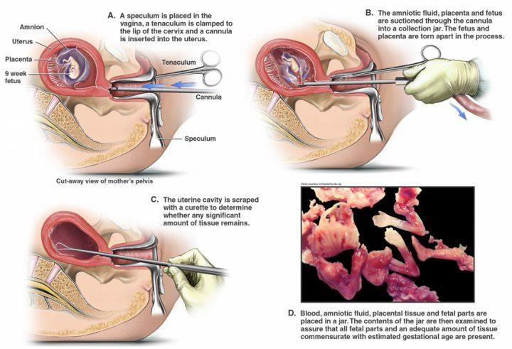
http://clinicquotes.com/how-a-suction-abortion-is-performed/

Slide 47
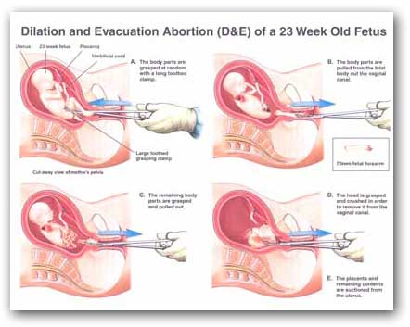

Slide 48
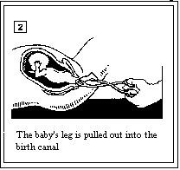

Slide 49
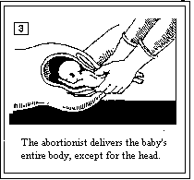

Slide 50
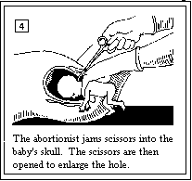

Slide 51
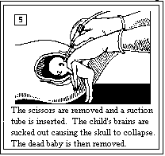

Slide 52
Drug induced abortion
Drug induced abortion works by taking two drugs.
The first drug (usually mifeprex) poisons the placenta, which is the connection between the mother and the human being in her womb, causing the baby to die of starvation.
The second drug (usually misoprostol/Cytotec) causes the mother’s womb to squeeze out the baby.

Slide 53
Is abortion healthcare?
But these drugs don’t always work. The further along a woman is in pregnancy, the more likely the drugs fail.
Then what happens to the woman?
Hemorrhage
Infection
Surgical complications
Incomplete abortion
Ongoing pregnancy
Death

Slide 54
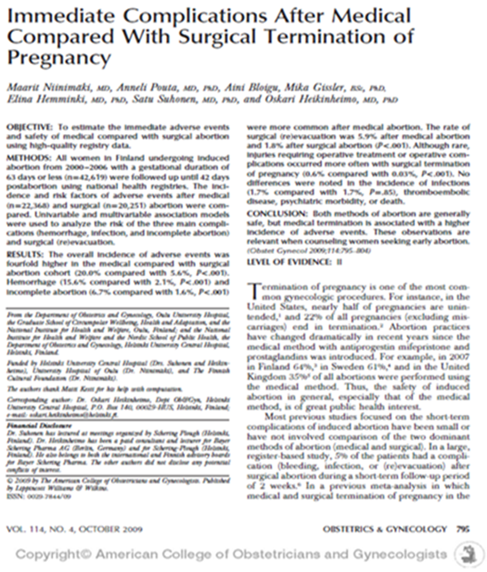
Is abortion healthcare?
20 out of every 100 women with a significant adverse event after mifeprex abortion including:
15 out of 100 women hemorrhage
7 out of every 100 women with tissue left inside
6 out of every 100 women needing surgery.

Slide 55
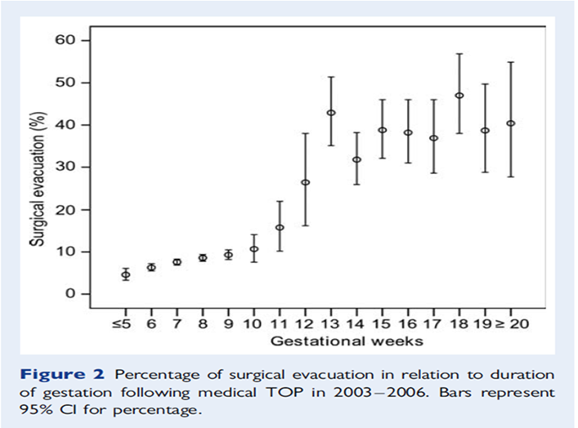
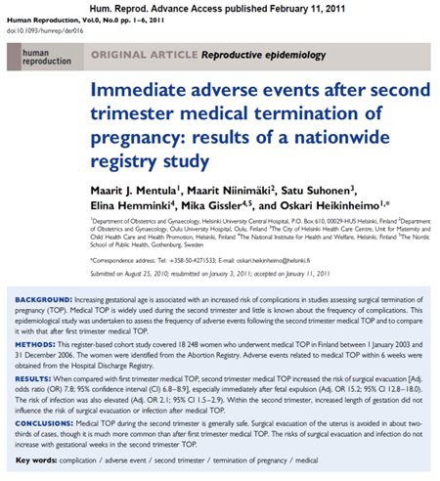
Is abortion healthcare?
The rate of surgical evacuation was 30.8%.

Slide 56
Is abortion healthcare?
http://abortionpillsrx.com
http://abortpregnancy.com
http://buygenericviagrarx.com
http://cialisgenericrx.com
http://endpregnancy.net
http://goabortion.com
http://nopregnancy.net
http://onlineabortionpillrx.com
http://realabortion.com
http://realabortionrx.com
http://zeepharmacy.biz
http://fragolapiccante.com
http://soltantosesso.com
http://homeabortionrx.com
http://abortion-online.com
http://abortionpillrx.com
http://abortionpills247.com
http://abortionrx.com
http://acedrugstore.com
http://buyabortionpillrx.net http://buyabortionpills.net
http://daynighthealthcare.com
http://daynighthealthcare247.com
http://fastabortion.com http://genericviagrarx.com
http://globalpharmacyrx.com
http://jellypharmacy.com
http://kamagrarx.biz
http://nestpillmart.net
http://northpharmacyrx.com
http://onlinegenericpill.com
http://onlinekitrx.com
http://onlinepillsrx.com
http://onlinepillsshop.net
http://onlinesmartdrugsrx.com
http://onlineviagrarx.com
http://pillsuppliers.com
http://realpharmacy.biz
http://realpharmacyrx.net
http://realpharmacyrxl.com
http://realpharmacyrxone.com
http://redpharmacyrx.com
http://royalpharmacy.net
http://safeabortionpillrx.com
http://safegenericrx.com
http://simplyviagra.com
http://simplyviagra.net
http://supremepharmacyrx.com
http://viagrageneric99.com
http://viagragenericrx.com
http://viagragenericrx.net
http://viagrapharmacyrx.com
http://xmaspharmacy.com
http://royalpharmacyrx.com
http://abortionkit.net
http://leonpharmacy.com
http://rablonhcare.wordpress.com
http://abortion-health.tumblr.com
http://abortionpillrx.cabanova.com
http://abortionpillsrx.tumblr.com
http://jamiecrews999.livejournal.com
http://medicalabortionpills.wordpress.com
http://womensmedicalcare.blogspot.com
http://birthcontrolpillsinfo.blogspot.com http://acedrugstore.blogspot.com
http://buyabortionpillrxnet.wordpress.com
http://buyabortionpills.ulcraft.com
http://safepregnancytermination.blogspot.com http://trustededpharmacy.blogspot.com
http://womensabortionpills.blogspot.com
http://nestpillmartpharmacy.weebly.com
http://birthcontrolpillsonline.blogspot.com
http://womenabortiondrugs.blogspot.com
http://onlineabortionpillrx.hatenablog.com
http://onlinegeneric.wordpress.com
http://onlinegenericpills.blogspot.com
http://onlinegenericpills.blogspot.in
http://onlinegenericpills.hatenablog.com
http://alternateabortiondrugs.blogspot.com
http://abortionpillonline.blogspot.com
http://royalpharmacyrx.blogspot.com
http://realpharmacyrxonline.wordpress.com
http://supremepharmacyrxblogs.wordpress.com
http://zeepharmacyblog.wordpress.com
http://rablon.net
http://rablon.com
http://rablonhealthcare.com

Slide 57
Is abortion healthcare?
No confirmation of gestational age
No concern about the exponentially increasing rate of hemorrhage and complications after 7 weeks gestation
No physician or health care provider
No ultrasound to confirm intrauterine location of the pregnancy or rule out ectopic pregnancy
No Rhogam given to Rh- women

Slide 58
Is abortion healthcare?
No concern about the potential lack of access to emergency room services
No concern about the fact that these online pill packages come without any package inserts or instructions,
No concern about the fact that "the 20 tablets labeled 200 mcg misoprostol contained between 34.1 mcg and 201.4 mcg of the active ingredient."
No confirmation of gestational age
No concern about the exponentially increasing rate of hemorrhage and complications after 7 weeks gestation

Slide 59
Is abortion healthcare?
No concern about the potential lack of access to emergency room services
No concern about the fact that these online pill packages come without any package inserts or instructions,
No concern about the fact that "the 20 tablets labeled 200 mcg misoprostol contained between 34.1 mcg and 201.4 mcg of the active ingredient."
No concern about the easy access for pimps and abusers who can get a discount for packages of 10 or more.
No screening for coerced abortion or trafficking

Slide 60
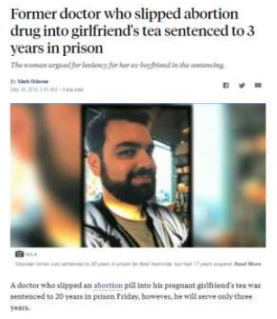
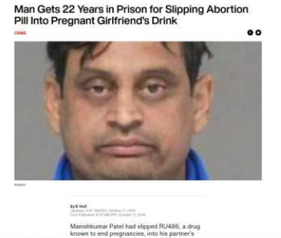
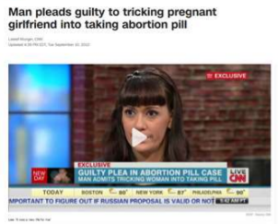
Is abortion healthcare?

Slide 61
5 Questions
What’s in her womb? A human being!
Which human beings should we value? We should value and protect all human beings inside or outside of the womb, from the beginning to the end of their life.
Is abortion healthcare?
If he can walk away, I can walk away?
Who is my neighbor? Pastor Stuckwisch

Slide 62
5 Questions
What’s in her womb? A human being!
Which human beings should we value? We should value and protect all human beings inside or outside of the womb, from the beginning to the end of their life.
Is abortion healthcare? NO!
If he can walk away, I can walk away?
Who is my neighbor? Pastor Stuckwisch

Slide 63
5 Questions
What’s in her womb? A human being!
Which human beings should we value? We should value and protect all human beings inside or outside of the womb, from the beginning to the end of their life.
Is abortion healthcare? NO!
If he can walk away, I can walk away?
Who is my neighbor? Pastor Stuckwisch

Slide 64
If he can walk away, I can walk away.

Slide 65
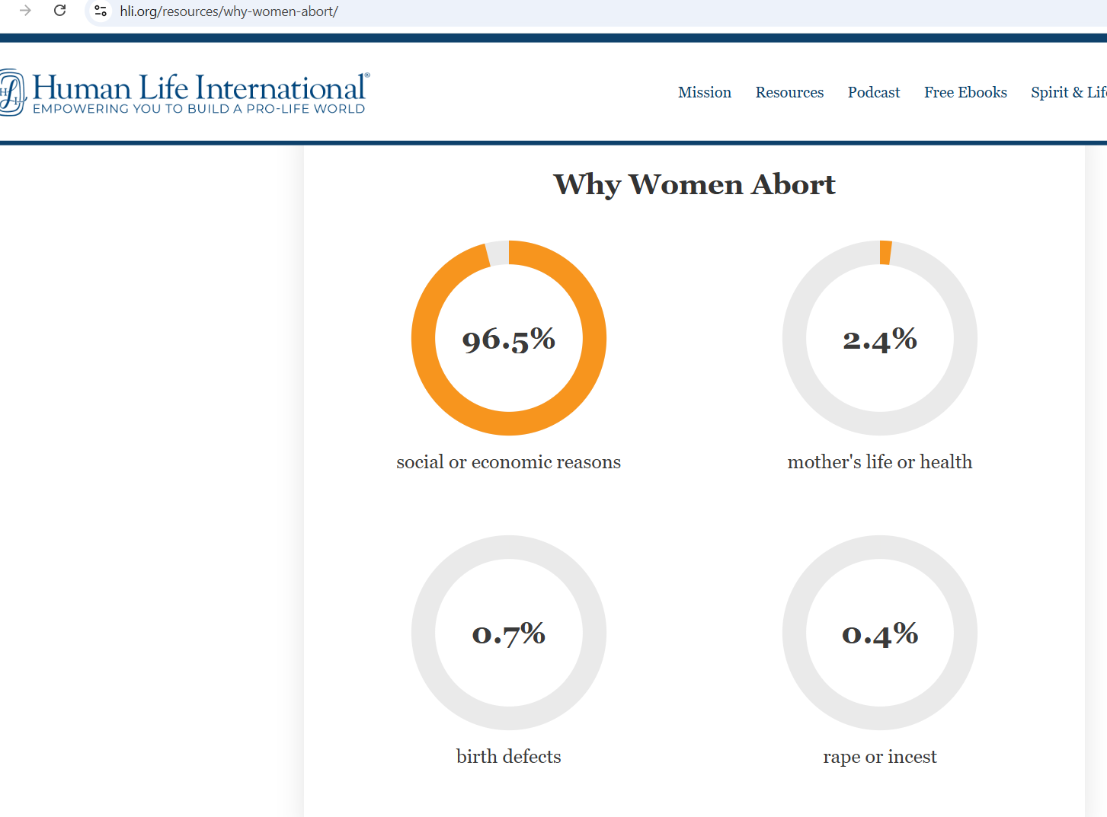
If he can walk away, I can walk away.
2.4 million aborted women
FL, LA, MN, NE, SD, UT
1996-2020
Data from abortion clinics required reporting.

Slide 66
If he can walk away, I can walk away.
38% of women indicate that the father of the baby was the most influential person in their abortion decision. (but in another study 55%)
57% of women who obtained an abortion experienced a potentially traumatic life event in the 12 months leading up to their abortion. The most common factors included unemployment, a breakup, or falling behind on rent or mortgage.
Only 12% of women included a physical problem with their health among reasons for having an abortion.
1% of women choosing abortion reported that they were the survivors of rape and less than half of one percent cited incest.
https://www.care-net.org/hubfs/Downloads/Top_40_Abortion_Statistics.pdf

Slide 67
If he can walk away, I can walk away.
“More than half of the women in the qualitative sample cited concerns about their relationship or single motherhood as a reason to end the pregnancy. Relationship problems included the partner's drinking, physical abuse, unfaithfulness, unreliability, immaturity and absence (often due to incarceration or responsibilities to his other children).
Many of these women were disappointed because their partner had reacted to the pregnancy by denying paternity, breaking off communication with them or saying that they did not want a child.
A small number of women stated that they were in new relationships and that it was too soon to have a child with their partner.”
https://www.guttmacher.org/journals/psrh/2005/reasons-us-women-have-abortions-quantitative-and-qualitative-perspectives

Slide 68
If he can walk away, I can walk away.
“Most who gave this reason had children already. They related how hard it was to raise children by themselves and how hard it would be to add another child to their families. Some felt depleted and alone:
"Well, I already had one son, and right now he's growing up without a father, just me and him.…If you ain't got a lot of help with the family support, it's really hard. Sometimes I can't handle it, but I have to, you know, for my son's sake.…I believe, right now, I'm gonna take care of myself and my son."—19-year-old, below the poverty line
A number of women stated that it was unfair to one's children to bring them up without a father figure.”
https://www.guttmacher.org/journals/psrh/2005/reasons-us-women-have-abortions-quantitative-and-qualitative-perspectives

Slide 69
If he can walk away, I can walk away.
“Opinions on adoption. Respondents were not specifically asked about adoption; nevertheless, it came up spontaneously in both parts of the study. While fewer than 1% of women in the quantitative survey volunteered that they would not consider or did not favor having a baby and giving it up for adoption, more than one-third of interview respondents said they had considered adoption and concluded that it was a morally unconscionable option because giving one's child away is wrong.”
https://www.guttmacher.org/journals/psrh/2005/reasons-us-women-have-abortions-quantitative-and-qualitative-perspectives

Slide 70
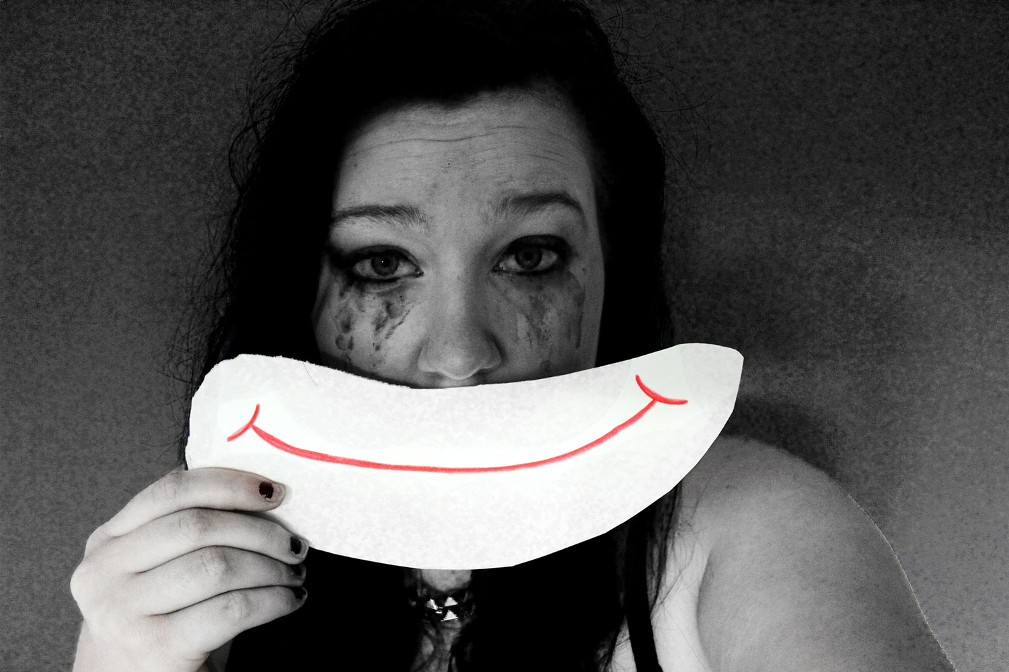
If he can walk away, I can walk away.
But…
I can’t.

Slide 71
If he can walk away, I can walk away. Not.
But…
I can’t.

Slide 72
If he can walk away, I can walk away. Not.
Pregnancy-associated deaths in Finland 1987-1994--definition problems and benefits of record linkage
Gissler M, Kauppila R, Meriläinen J, Toukomaa H, Hemminki E.
Stakes, (the National Research and Development Centre for Welfare and Health), Helsinki, Finland.
Acta Obstetrica et Gynecologica Scandinavica, 76:651-657, 1997

Slide 73
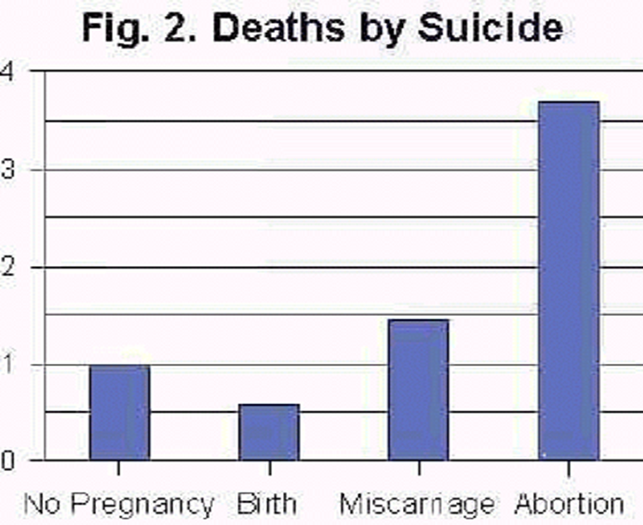
If he can walk away, I can walk away. Not.
Pregnancy-associated deaths in Finland 1987-1994--definition problems and benefits of record linkage
Gissler M, Kauppila R, Meriläinen J, Toukomaa H, Hemminki E.
Stakes, (the National Research and Development Centre for Welfare and Health), Helsinki, Finland.
Acta Obstetrica et Gynecologica Scandinavica, 76:651-657, 1997
Retrospective record review women ages (15-49) that died between 1987-1994 (n=9,192)

Slide 74
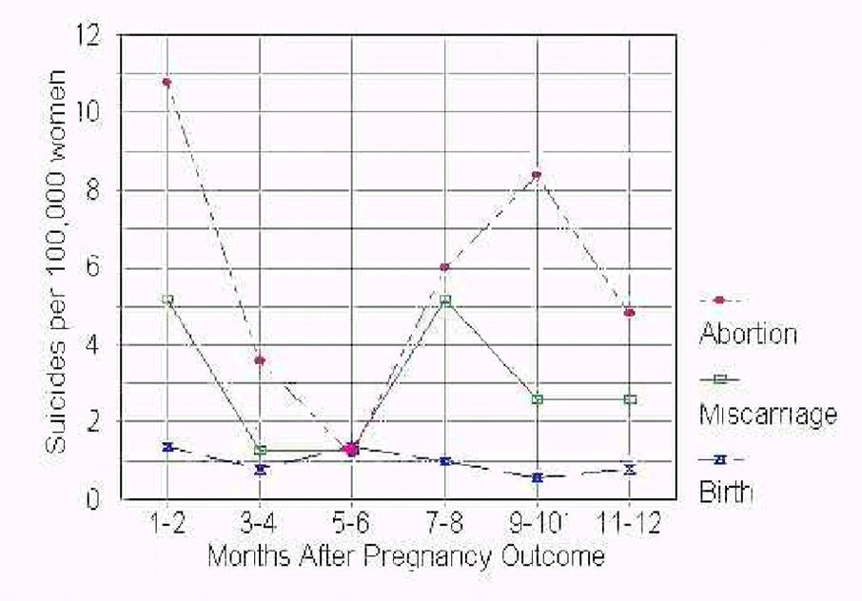
If he can walk away, I can walk away. Not.

Slide 75
If he can walk away, I can walk away. Not.
Pregnancy-associated deaths in Finland 1987-1994--definition problems and benefits of record linkage
Gissler M, Kauppila R, Meriläinen J, Toukomaa H, Hemminki E.
Stakes, (the National Research and Development Centre for Welfare and Health), Helsinki, Finland.
Acta Obstetrica et Gynecologica Scandinavica, 76:651-657, 1997
“interview-based studies… have consistently shown extraordinarily high levels of suicidal ideation (30-55 percent)
and reports of suicide attempts (7-30 percent) among women who have had an abortion.”

Slide 76

If he can walk away, I can walk away. Not.
Pregnancy-associated deaths in Finland 1987-1994--definition problems and benefits of record linkage
Gissler M, Kauppila R, Meriläinen J, Toukomaa H, Hemminki E.
Stakes, (the National Research and Development Centre for Welfare and Health), Helsinki, Finland.
Acta Obstetrica et Gynecologica Scandinavica, 76:651-657, 1997
“In many of these studies, the women interviewed have explicitly described the abortion as the cause of their suicidal impulses”

Slide 77
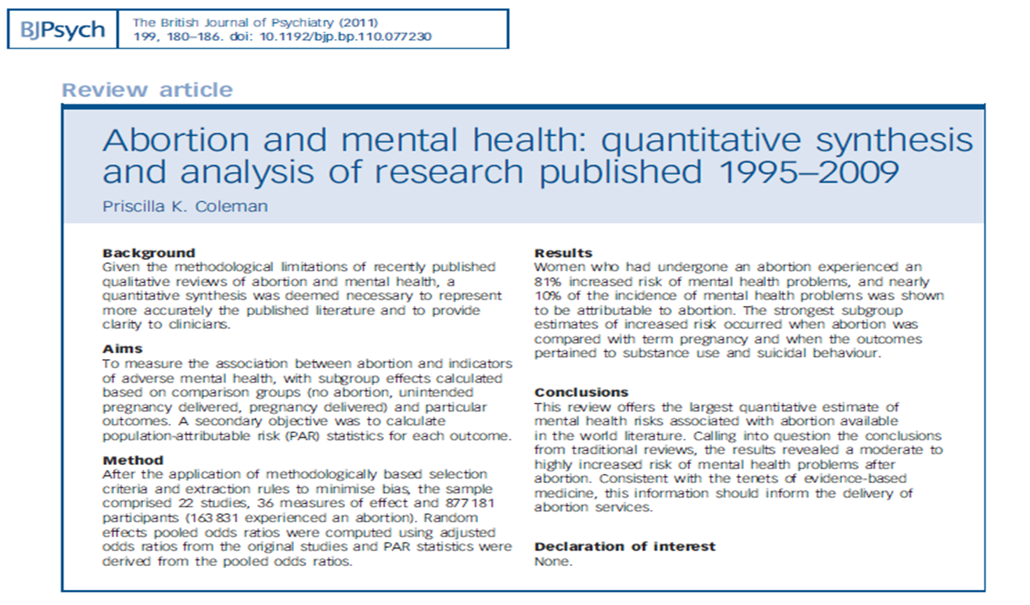
If he can walk away, I can walk away. Not.
Abortion and mental health: quantitative synthesis and analysis of research published 1995-2009.
Coleman P.
British Journal of Psychiatry (2011) 199 180-186.
Meta-analysis of 22 published studies
877,181 participants

Slide 78
If he can walk away, I can walk away. Not.
Women who have had an abortion experience:
an 81% overall increased risk for mental health problems after the abortion.

Slide 79
If he can walk away, I can walk away. Not.
Women who have had an abortion experience:
A 34% increased risk for anxiety disorders
37% increased risk for major depression

Slide 80
If he can walk away, I can walk away. Not.
Women who have had an abortion experience:
110% increased risk for alcohol abuse
220% increased risk for marajuana abuse

Slide 81
If he can walk away, I can walk away. Not.
Women who have had an abortion experience:
A 155% increased risk of suicide attempts.

Slide 82
If he can walk away, I can walk away. Not.
Women who have had an abortion experience:
A 55% increased risk of mental health problems when compared to an unintended pregnancy carried to term.

Slide 83
If he can walk away, I can walk away. Not.
Approximately 10% of the incidence of mental health problems in the study were shown to be directly attributable to the abortion.

Slide 84
If he can walk away, I can walk away. Not.
Guilt
Anxiety
Avoiding Children or Pregnant Women
Feeling “Numb”
Depression
Thoughts of suicide
Anniversary Reminders
Experiencing the abortion again
Wanting to get pregnant again
Fear of infertility
Unable to bond with children
Fear that children will die
Eating disorders
Alcohol and Drug use

Slide 85
5 Questions
What’s in her womb? A human being!
Which human beings should we value? We should value and protect all human beings inside or outside of the womb, from the beginning to the end of their life.
Is abortion healthcare? NO!
If he can walk away, I can walk away?
Who is my neighbor? Pastor Stuckwisch

Slide 86
5 Questions
What’s in her womb? A human being!
Which human beings should we value? We should value and protect all human beings inside or outside of the womb, from the beginning to the end of their life.
Is abortion healthcare? NO!
If he can walk away, I can walk away? No, I can’t walk away.
Who is my neighbor? Pastor Stuckwisch

Slide 87
5 Questions
What’s in her womb? A human being!
Which human beings should we value? We should value and protect all human beings inside or outside of the womb, from the beginning to the end of their life.
Is abortion healthcare? NO!
If he can walk away, I can walk away? No, I can’t walk away.
Who is my neighbor? Pastor Stuckwisch

