Slide 1
Contraception
Men’s Gathering
Donna J. Harrison M.D.
April 10, 2026

Slide 2
Questions that this lecture
Cannot answer
Will try to answer
Should a couple use contraception?
What kind of contraception should a couple use?
Can embryos be formed using contraceptives?
If an embryo is formed during the use of a certain kind of contraceptive method, what environment does that embryo face?
How can we evaluate the risk to the embryo?

Slide 3
The symphony of a woman’s body

Slide 4
The symphony of a woman’s body
menses (day 1- 7)

Slide 5
The symphony of a woman’s body
menses (day 1- 7)
“follicular” phase ( day 7-11)

Slide 6
The symphony of a woman’s body
menses (day 1- 7)
“follicular” phase ( day 7-11)
ovulation (day 12)
fertilization(day 12)
implantation (day 21)
early pregnancy (role of progesterone and the corpus luteum of pregnancy)

Slide 7
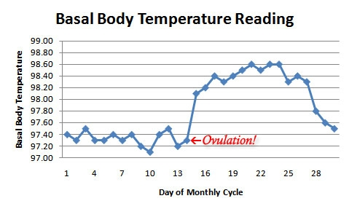
http://www.squidoo.com/when-do-women-ovulate-start-your-menstrual-cycle-chart

Slide 8
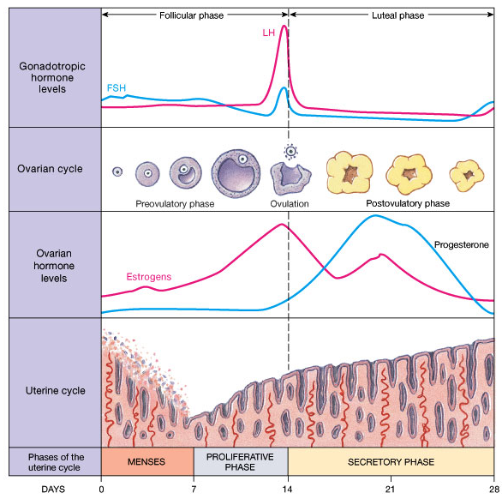
http://www.squidoo.com/when-do-women-ovulate-start-your-menstrual-cycle-chart

Slide 9
An embryo forms within 24 hours after egg release (ovulation)
Mom misses her period
Embryo implants 5-7 days after creation
http://drfiona.whitelotusclinic.ca/2010/03/hormones-and-mood-pms/

Slide 10
An embryo forms within 24 hours after egg release (ovulation)
Mom misses her period
Embryo implants 5-7 days after creation
http://drfiona.whitelotusclinic.ca/2010/03/hormones-and-mood-pms/

Slide 11
Mom misses her period
http://drfiona.whitelotusclinic.ca/2010/03/hormones-and-mood-pms/

Slide 12
An embryo forms within 24 hours after egg release (ovulation)
Mom misses her period
Embryo implants 5-7 days after creation
http://drfiona.whitelotusclinic.ca/2010/03/hormones-and-mood-pms/

Slide 13
The words matter
Fertilization
Fertilization is the process of fusion of a sperm (male gamete) and an egg (female gamete) to form an embryo.
At the moment when the sperm penetrates the egg, a unique living human being begins.

Slide 14
The words matter
Fertilization
Embryo
An embryo defined as the youngest form of a being.
An embryo is formed the moment of sperm egg membrane fusion. (The one celled embryo is given a special name “zygote”.)
SCIENTIFICALLY, THERE IS NO SUCH THING AS A “FERTILIZED EGG”.

Slide 15
The words matter
Fertilization
Embryo
Implantation
Implantation is the process of the embryo attaching to the lining of the uterus.

Slide 16
The words matter
Fertilization
Embryo
Implantation
“Conception”
From the mid 1800’s, when the science of embryology began, “conception” was a lay term for fertilization.
Many people believe that “life begins at conception”.

Slide 17
The words matter
“Contra-ception” is a word invented in the 1960’s to describe the prevention of “conception”.
At the same time, ACOG changed the legal meaning of “conception” to be the point of embryo implantation, so that
This change in definition allowed for the use drugs and devices which act after fertilization but before implantation to be technically classified as “contraceptives”.
Fertilization
Embryo
Implantation
“Conception”
“Contra-ception”

Slide 18
The words matter
Fertilization
Embryo
Implantation
“Conception”
“Contra-ception”
So, using the current legal ACOG definition, a “Contraceptive” is any drug or device which prevents the formation of a recognized pregnancy.
Recognized pregnancy happens when bHCG is detected, 2 weeks AFTER fertilization and 1 week after implantation.

Slide 19
The words matter
Fertilization
Embryo
Implantation
“Conception”
“Contra-ception”
“Contraceptives” can work by any or all of the following:
Preventing the egg from being released,
Preventing sperm from meeting the egg, or
Preventing the embryo from implanting in the uterus.

Slide 20
The words matter
Fertilization
Embryo
Implantation
Fetus
“Conception”
“Contra-ception”
“Abortion”
An “abortion” is the ending of a “pregnancy”.
Since the current legal definition of “conception” = implantation, then “pregnancy” legally begins at the completion of implantation.
The term “abortifacient” is for drugs and devices which end the life of an embryo after implantation.
So, technically, if a “contraceptive” acts after fertilization, but before implantation, it cannot be classified as an “abortifacient”.
“Embryocidal” is a better term.

Slide 21
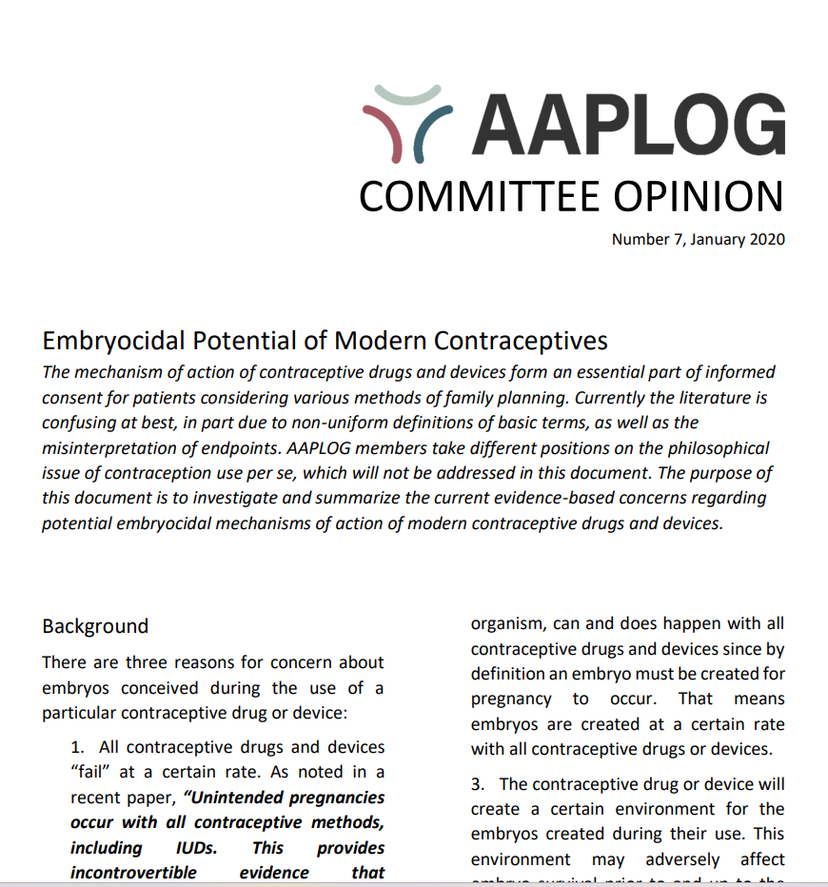
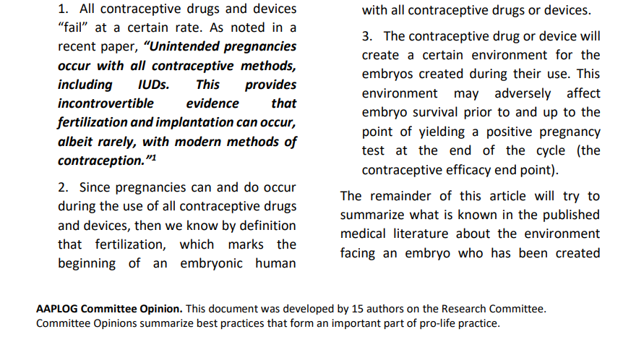
AAPLOG Committee Opinion 7: Embryocidal Potential of Modern Contraceptives.
Jan 2020
Available at: https://aaplog.org/wp-content/uploads/2024/05/Committee-Opinion-7-updated.pdf

Slide 22
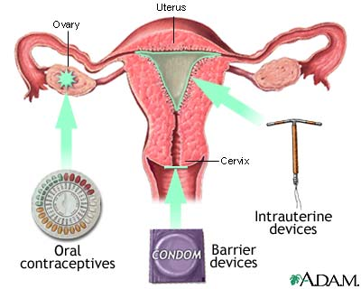
Types of Contraceptives
http://www.nlm.nih.gov/medlineplus/ency/imagepages/19068.htm
The different methods of contraception include:
Barrier methods
Intrauterine methods
Hormonal methods
http://www.nichd.nih.gov/health/topics/contraception/conditioninfo/pages/types.aspx

Slide 23
Types of Contraceptives
http://www.nlm.nih.gov/medlineplus/ency/imagepages/19068.htm
The different methods of contraception include:
Barrier methods
http://www.nichd.nih.gov/health/topics/contraception/conditioninfo/pages/types.aspx

Slide 24
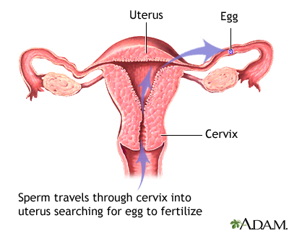
Barrier Methods
http://www.nlm.nih.gov/medlineplus/ency/presentations/100107_2.htm
The different methods of contraception include:
Barrier methods (reversible)
Hormonal methods
Emergency contraception
Intrauterine methods
Sterilization
Sperm release and egg release happen.
Barrier methods attempt to prevent the sperm from reaching the egg.
No perfect barrier exists so spermicides are used to kill residual sperm.
http://www.nichd.nih.gov/health/topics/contraception/conditioninfo/pages/types.aspx

Slide 25
Barrier Methods
http://www.nlm.nih.gov/medlineplus/ency/presentations/100107_2.htm
The different methods of contraception include:
Barrier methods (reversible)
Hormonal methods
Emergency contraception
Intrauterine methods
Sterilization
Two kinds of barrier methods:
REVERSIBLE
PERMANENT
http://www.nichd.nih.gov/health/topics/contraception/conditioninfo/pages/types.aspx

Slide 26
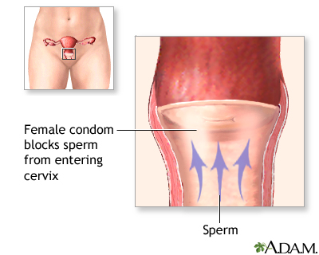
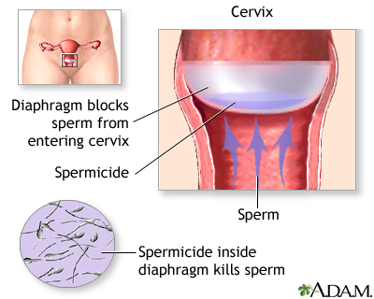
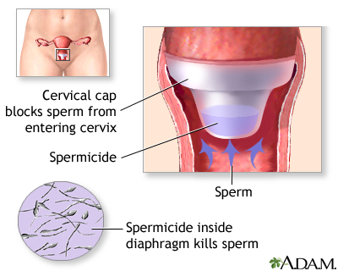
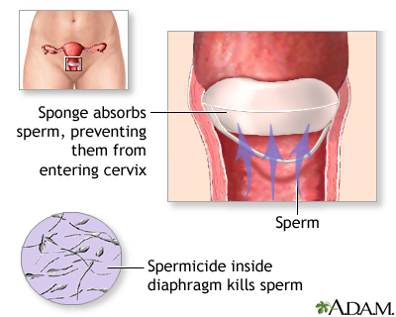
Reversible Barrier Methods
If an embryo is formed during the use of reversible barrier methods of contraception, there is no change in the woman’s reproductive tract.
NO KNOWN HARM TO THE EMBRYO
http://www.nlm.nih.gov/medlineplus/ency/presentations/100107_6.htm

Slide 27
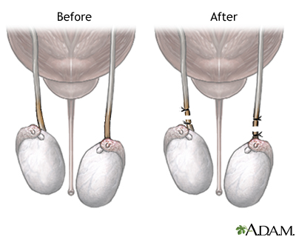
Permanent Barrier Methods
http://www.nlm.nih.gov/medlineplus/ency/imagepages/10017.htm
Vasectomy (male)
A portion of the vas deferens (tube which connects the testicles to the sperm storage region near the prostate gland) is removed, burned or tied off so that there is tubal blockage preventing sperm passage.

Slide 28
Permanent Barrier Methods
http://www.nlm.nih.gov/medlineplus/ency/imagepages/10017.htm
Vasectomy (male)
If an embryo is formed after a vasectomy, the embryo would not encounter any changes in his or her mother’s reproductive tract.
So an embryo formed after vasectomy faces the same environment in the womb as if the vasectomy didn’t happen.
No Known Harm to Embryo

Slide 29
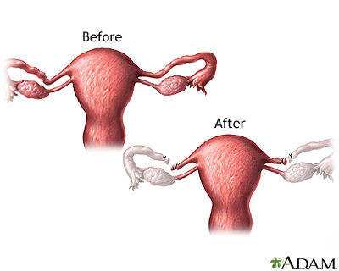
Permanent Barrier Methods
http://www.nlm.nih.gov/medlineplus/ency/presentations/100044_3.htm
Tubal ligation (female)
A portion of the tube is removed, burned or otherwise blocked, so that there is a tubal scarring or blockage which prevents the sperm from reaching the egg.
The tube is permanently scarred

Slide 30
Permanent Barrier Methods
http://www.nlm.nih.gov/medlineplus/ency/presentations/100044_3.htm
Tubal ligation (female)
If an embryo is formed after a tubal ligation, the tubal scarring makes it more likely that an embryo will implant in the tubes instead of in the womb. This is called an “ectopic” pregnancy.
As an ectopic pregnancy grows, it ruptures the tube. The ectopic pregnancy must be removed because rupture of the tube can quickly kill the mother.

Slide 31
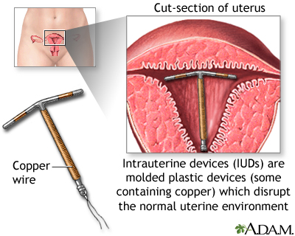
Intrauterine Methods
http://www.nlm.nih.gov/medlineplus/ency/imagepages/17078.htm
The different methods of contraception include:
Barrier methods
Intrauterine methods
http://www.nichd.nih.gov/health/topics/contraception/conditioninfo/pages/types.aspx

Slide 32
Intrauterine Methods
http://www.nlm.nih.gov/medlineplus/ency/imagepages/17078.htm
“A copper IUD prevents sperm from reaching and fertilizing the egg, and it may prevent the egg from attaching in the womb. If fertilization of the egg does occur, the physical presence of the device prevents the fertilized egg from implanting into the lining of the uterus.”
http://www.nichd.nih.gov/health/topics/contraception/conditioninfo/pages/types.aspx

Slide 33
Intrauterine Methods
http://www.nlm.nih.gov/medlineplus/ency/imagepages/17078.htm
“A hormonal IUD or IUS releases a progestin hormone (levonorgestrel) into the uterus. The released hormone causes thickening of the cervical mucus, inhibits sperm from reaching or fertilizing the egg, thins the uterine lining, and may prevent the ovaries from releasing eggs.”
http://www.nichd.nih.gov/health/topics/contraception/conditioninfo/pages/types.aspx

Slide 34
Intrauterine Methods
http://www.nlm.nih.gov/medlineplus/ency/imagepages/17078.htm
Embryos formed during the use of either a copper IUD or hormonal IUD will almost always die.
The presence of the IUD inside the uterus sets up an inflammation in the lining which makes implantation difficult or impossible.
If implantation has taken place, the IUD will disrupt the implantation site, causing an abortion.
Embryos die

Slide 35
Intrauterine Methods
“Moreover, if it was conclusively shown that the sole or principal mode of action was to prevent the embryo from implanting, then this method, as in the case with emergency contraception, would be considered by the Roman Catholic church as causing an early abortion. As a result many agencies involved in the research, development or delivery of contraception prefer to leave the mechanism of action issue unresolved, which may explain why research into the contraceptive mechanisms of IUDs has been sparse in the last 20 years.” (bold underlined emphasis mine)
ESHRE Capri Workshop Group: IUDs
Human Reproduction Update Vol 14 (3) pp 197-208 2008

Slide 36
Intrauterine Methods
“There is sufficient evidence to suggest that IUDs can prevent and disrupt implantation. The extent to which this interference contributes to its contraceptive action is unknown. The data are scanty and the political consequences of resolving this issue interfere with comprehensive research.” (bold underline emphasis mine)
ESHRE Capri Workshop Group: IUDs
Human Reproduction Update Vol 14 (3) pp 197-208 2008

Slide 37
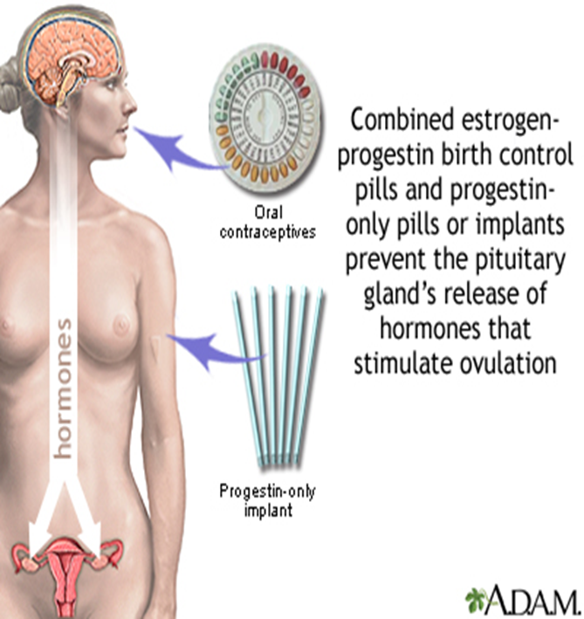
Types of Contraceptives
http://www.nlm.nih.gov/medlineplus/ency/imagepages/19068.htm
The different methods of contraception include:
Barrier methods
Intrauterine methods
Hormonal methods
http://www.nichd.nih.gov/health/topics/contraception/conditioninfo/pages/types.aspx

Slide 38
Hormonal Methods
“Hormonal methods of birth control use hormones to regulate or stop ovulation and prevent pregnancy… Hormones can be introduced into the body through various methods, including pills, injections, skin patches, transdermal gels, vaginal rings, intrauterine systems, and implantable rods. Depending on the types of hormones that are used, these pills can prevent ovulation; thicken cervical mucus, which helps block sperm from reaching the egg; or thin the lining of the uterus. Health care providers prescribe, monitor, and administer hormonal contraceptives.”
http://www.nichd.nih.gov/health/topics/contraception/conditioninfo/pages/types.aspx

Slide 39
Hormonal Methods
“The pill works in several ways to prevent pregnancy. The pill suppresses ovulation so that an egg is not released from the ovaries, and changes the cervical mucus, causing it to become thicker and making it more difficult for sperm to swim into the womb. The pill also does not allow the lining of the womb to develop enough to receive and nurture a fertilized egg.”
http://www.nlm.nih.gov/medlineplus/ency/imagepages/17101.htm

Slide 40
An embryo forms within 24 hours after egg release (ovulation)
Mom misses her period
Embryo implants 5-7 days after creation
http://drfiona.whitelotusclinic.ca/2010/03/hormones-and-mood-pms/

Slide 41
http://drfiona.whitelotusclinic.ca/2010/03/hormones-and-mood-pms/

Slide 42
One out of 50 times, a normal LH
Yields normal progesterone
Embryo can implant
http://drfiona.whitelotusclinic.ca/2010/03/hormones-and-mood-pms/

Slide 43
Roughly half of the time, there is enough LH to allow for egg is released
Threshold for egg release
But too little progesterone to
allow the lining to develop.
Embryos cannot implant.
So the embryo dies. “Thin lining”
But too little progesterone to allow
An embryo to implant
http://drfiona.whitelotusclinic.ca/2010/03/hormones-and-mood-pms/

Slide 44
Roughly a little less than half of the time very little LH is made.
No egg is released
Threshold for egg release
http://drfiona.whitelotusclinic.ca/2010/03/hormones-and-mood-pms/

Slide 45

What are the Hoogland criteria?
Hoogland Ovulation
Dominant follicle >13mm
US documentation of decrease in follicle size by 50% or more within 2-4 days (“follicular rupture”)
E > 0.1nmol/L in follicular phase
P > 5nmol/L in luteal phase
Hoogland LUF
Dominant follicle >13mm
US documentation of decrease in follicle size by less than 50% or not within 2-4 days, nor not occuring at all (“no follicular rupture”)
E > 0.1nmol/L in follicular phase
P > 5nmol/L in luteal phase
Hoogland Active FLS
Dominant follicle >13mm
Follicular rupture or no follicular rupture
E > 0.1nmol/L in follicular phase
P < 5nmol/L in luteal phase
Hoogland Non-Active FLS
Dominant follicle >13mm
Follicular rupture or no follicular rupture
E < 0.1nmol/L in follicular phase
P > 5nmol/L in luteal phase
Hoogland and Skouby 1993
Harrison et al 2018

Slide 46
Hormonal Methods
Somewhere between 2% and 60% of cycles have egg release.
It is not known how many of those eggs are fertilized and embryos formed. (need a fertilization marker)
All hormonal contraceptives interfere with progesterone production by a woman’s ovary. Without enough progesterone, the embryo dies.
Progestin only contraceptives also interfere with the transport of the embryo to the womb.
All hormonal contraceptives interfere with the development of the endometrial lining so that embryos are much less likely to be able to implant.

Slide 47
Emergency Contraceptives
Plan B (High dose Progestin)
One or two pills of high dose progestin taken once (or two doses 12 hours apart).
Can possibly delay egg release if taken 4-2 days before ovulation.
But the closer to ovulation, the greater the possibility of egg release.
If taken the day before ovulation…all eggs are released, but no “pregnancies” happen.
Taken after egg release, Plan B apparently does very little.
No interference with sperm transport.
If Plan B is taken shortly before before ovulation, the woman does not make sufficient progesterone to support the embryo.

Slide 48
Threshold for egg release
But too little progesterone to
allow the lining to develop.
Embryos cannot implant.
So the embryo dies. “Thin lining”
But too little progesterone to allow
An embryo to implant
http://drfiona.whitelotusclinic.ca/2010/03/hormones-and-mood-pms/

Slide 49
Emergency Contraceptives
Ella (Ulipristal 2nd gen RU-486)
Blocks progesterone in cells, just like RU-486. Equipotent.
Can possibly delay egg release if taken 4-2 days before ovulation.
But the closer to ovulation, the greater the possibility of egg release.
If taken the day before ovulation…all eggs are released, but no “pregnancies” happen.
Unlike Plan B, Ella is VERY EFFECTIVE after egg release.
No interference with sperm transport.
Ella can prevent egg release, prevent implantation and kill an embryo which has already implanted-causing an abortion just like it’s parent drug RU-486.

Slide 50
Threshold for egg release
But too little progesterone to
allow the lining to develop.
Embryos cannot implant.
So the embryo dies. “Thin lining”
But too little progesterone to allow
An embryo to implant
http://drfiona.whitelotusclinic.ca/2010/03/hormones-and-mood-pms/

Slide 51
3 Key questions to ask your doctor:
1. Does this method ever “fail”?
Clue: ALL methods have a published “failure rate” which is the rate at which pregnancies are detected in women using this method.
In other words, ALL METHODS allow sperm to reach the egg and allow pregnancy to happen at some rate.
This “failure rate” can vary depending on the type of contraceptive used.

Slide 52
3 Key questions to ask your doctor:
1. Does this method ever “fail”?
ALL methods have a published “failure rate” which is the rate at which pregnancies are detected in women using this method.
In other words, ALL METHODS allow sperm to reach the egg and allow pregnancy to happen at some rate.
This “failure rate” can vary depending on the type of contraceptive used.
2. When an embryo is formed inside my body, are my natural body processes somehow changed by the contraceptive drug or device in ways that make it more difficult for my embryonic child to survive?
Tubal ligation
IUD
Hormonal contraceptives including “morning after” pills

Slide 53
3 Key questions to ask your doctor:
1. Does this method ever “fail”?
ALL methods have a published “failure rate” which is the rate at which pregnancies are detected in women using this method.
In other words, ALL METHODS allow sperm to reach the egg and allow pregnancy to happen at some rate.
This “failure rate” can vary depending on the type of contraceptive used.
2. When an embryo is formed inside my body, are my natural body processes somehow changed by the contraceptive drug or device in ways that make it more difficult for my embryonic child to survive?
Tubal ligation
IUD
Hormonal contraceptives including “morning after” pills
3. Can this method kill an embryo which is already implanted?
IUD and Ella

